Slide 1

Mini Project Presentation
On AI – Based Proctoring System
23R21A1272 - C. RUSHIKA
23R21A1291 - M. SAI SREE
23R21A12A3 - N. CHANDANA
24R25A1210 - M.ROHINI
Under the Guidance of
Mrs.J.Adilakshmi
Assistant Professor
Department of Information Technology
Team No: 15
1

Slide 2

CONTENTS
Abstract
Introduction
Literature Survey
Objectives
Existing System & Disadvantages
Proposed System & Advantages
Architecture Diagram
System Requirements (H/W & S/W)
Methodology
Result and Discussion
Conclusion and Future Enhancement
References
Team No: 15
2

Slide 3
ABSTRACT
With the rapid growth of online examinations for academics, certifications, and internship selection, maintaining exam integrity has become a major challenge. Traditional online proctoring methods rely heavily on human invigilators or basic screen monitoring, which are costly, biased, and inefficient for large-scale exams. This project proposes an “AI-Based Proctoring System” that uses computer vision techniques to automatically monitor students through a webcam during online exams. The system detects suspicious behaviors such as face absence, head movement, eye diversion, and presence of multiple faces. A trust score mechanism is used instead of immediate disqualification to ensure fairness. This solution is cost-effective, scalable, and suitable for modern online assessments where credibility and transparency are critical.
Team No: 15
3

Slide 4
INTRODUCTION
The AI-Based Proctoring System is an intelligent solution designed to ensure fairness and integrity in online examinations conducted for academics, certifications, internships, and recruitment processes. As online exams continue to grow, traditional proctoring methods that rely on human invigilators have become inefficient and difficult to scale. This project uses artificial intelligence and computer vision techniques to automatically monitor candidates through a webcam, acting as a digital invigilator. The system verifies the candidate’s identity, tracks eye and head movements, and detects multiple faces to identify suspicious behavior during the exam. Instead of immediate disqualification, a trust score mechanism is used to maintain fairness. Overall, the system provides a reliable and automated solution for conducting secure online examinations.
Team No: 15
4

Slide 5
LITERATURE SURVEY
No | Title | Author | Journal Name & Year | Methodology Adapted | Key Findings | Gaps
1 | Online Examination Proctoring: Challenges and Solutions | Smith et al | International Journal of Educational Technology (2018) | Manual and webcam based proctoring | Highlighted the need for monitoring online exams | Highly dependent on human invigilators
2 | Face Detection-Based Online Exam Monitoring System | Lee & Park | IEEE International Conference on E Learning (2019) | Face detection using webcam | Verified student presence during exams | Cannot detect eye or head movements
3 | Automated Online Exam Proctoring Using Machine Learning | Chen et al | Journal of Computer Applications (2020) | ML-based anomaly detection | Reduced manual supervision | Cannot detect physical cheating
Team No: 15 5

Slide 6
LITERATURE SURVEY
No | Title | Author | Journal Name & Year | Methodology Adapted | Key Findings | Gaps
5 | Intelligent Remote Exam Monitoring Using AI | Rahman & Ahmed | International Journal of Advanced Computer Science (2021) | AI + ML models for behaviour analysis | AI models can detect unusual behaviors and reduce cheating risk | Limited real-time feedback for students
6 | Automated Online Proctoring with Multi Modal Data | Singh et al | IEEE Transactions on Learning Technologies (2022) | Combined face, gaze, and voice analysis | Multi-modal analysis increases detection accuracy and reliability | Complex implementation, requires high-quality webcam and mic
Team No: 15 6

Slide 7
OBJECTIVES
To create and implement an intelligent AI-based proctoring system that enables secure, efficient, and fair online examination monitoring.
To use advanced artificial intelligence and computer vision techniques to capture, process, and analyze real-time video and audio data of students during examinations.
To develop models that can detect suspicious behaviors such as multiple faces, unusual head movements, eye gaze deviation, and the presence of unauthorized objects like mobile phones or books.
To generate real-time alerts and detailed analytical reports that help in identifying malpractice and ensuring exam integrity.
To improve the overall effectiveness of online examination systems by reducing human effort, minimizing cheating, and enhancing scalability for large numbers of students.
Team No: 15 7

Slide 8
EXISTING SYSTEM
1. Manual Invigilation System :The manual invigilation system is the traditional method used in offline examinations where human invigilators monitor students in examination halls. Invigilators observe candidates, ensure rules are followed, and identify suspicious behavior during the exam. This system depends entirely on human judgment and physical presence, making it effective in controlled environments but limited by factors such as human error, fatigue, and difficulty in managing large-scale examinations.
2. Basic Online Examination System :Basic online examination systems are used to conduct exams through digital platforms where students can log in, attend tests, and submit answers remotely. These systems provide convenience and accessibility but lack proper monitoring mechanisms. As a result, students can easily engage in unfair practices like using external resources or switching tabs, making the system less secure and unreliable.
Team No: 15 8

Slide 9
DISADVANTAGES OF EXISTING SYSTEM
Lack of Proper Monitoring : Basic systems do not provide continuous monitoring of students during exams. This makes it difficult to track real-time behavior and activities.
High Chances of Cheating : Students can easily use mobile phones, books, or take external help. There are no strong mechanisms to prevent unfair practices.
Human Errors in Manual Invigilation : Invigilators may miss suspicious activities due to fatigue or distraction. This reduces the accuracy and reliability of monitoring.
Not Scalable for Large Exams : It is difficult to manage a large number of students at the same time. More invigilators are required, increasing complexity.
Time-Consuming and Costly : Manual supervision requires more time and human resources. This increases the overall cost of conducting exams.
Team No:15 9

Slide 10
PROPOSED SYSTEM
The proposed system is an AI-based proctoring system designed to monitor students during online examinations using advanced technologies like artificial intelligence and computer vision. It captures real-time video and audio data through the student’s webcam and microphone for continuous monitoring. The system analyzes facial expressions, eye movements, and head position to track student behavior. It also detects suspicious activities such as multiple faces, looking away, or the use of unauthorized objects like mobile phones or books. When such activities are identified, the system generates instant alerts. All activities are recorded and stored for further analysis. After the exam, a detailed report along with a trust score is generated for each student. This helps administrators evaluate exam integrity effectively. Overall, the system ensures a secure, fair, and reliable online examination environment.
Team No: 15 10

Slide 11
ADVANTAGES OF PROPOSED SYSTEM
The proposed system provides real-time monitoring of students during online examinations, ensuring continuous observation and immediate detection of suspicious activities.
It uses advanced AI techniques and computer vision to accurately detect cheating behaviors like multiple faces, eye movement, and unauthorized object usage.
The system reduces the need for human invigilators by automating the monitoring process, thereby saving time and effort.
It is highly scalable and can handle a large number of students simultaneously, making it suitable for large-scale online examinations.
The system is cost-effective as it minimizes expenses related to manual supervision and physical infrastructure.
Team No: 15 11

Slide 12
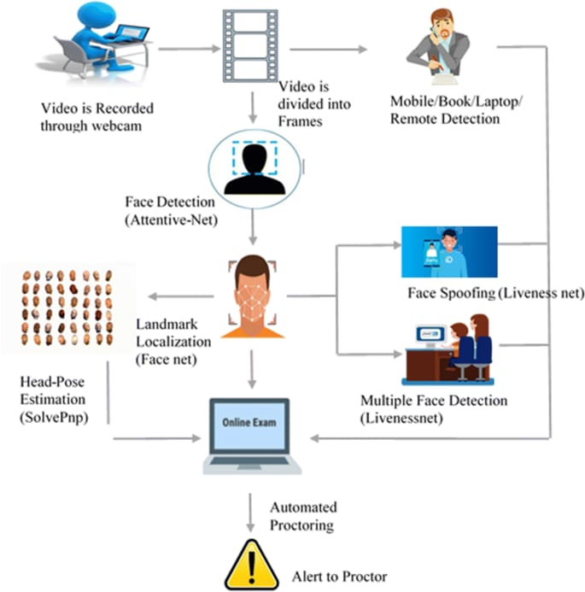
ARCHITECTURE DIAGRAM
Fig : Architecture Diagram
Team No: 15
12

Slide 13
SYSTEM REQUIREMENTS
HARDWARE REQUIREMENTS:
• Processor: Minimum Intel i3 or equivalent; recommended Intel i5 or higher
• RAM: At least 4 GB (8 GB recommended for smooth performance)
• Camera: HD webcam (720p or higher) for face detection and monitoring
• Microphone: Required for audio monitoring and detecting suspicious sounds
• Storage: Minimum 500 MB free space for application and logs
• Display: Standard monitor or laptop screen
SOFTWARE REQUIREMENTS:
• Operating System: Windows, Linux, or macOS
• Browser/Application: Google Chrome, Firefox, or dedicated proctoring app
• Programming Languages: Python, Java, or JavaScript for AI model integration
• Frameworks/Libraries: OpenCV (for image processing) TensorFlow / PyTorch (for AI models)
• Database: MySQL, MongoDB, or PostgreSQL
• Server: Cloud server or local server for data processing
Team No: 15
13

Slide 14
METHODOLOGY
1. Exam Setup & Authentication Module :
User Login System: Students log in using secure credentials to access the exam portal. Exam Setup Dashboard: Displays exam URL, time limit, and important instructions to be followed. Webcam & System Check: Performs camera, microphone, and environment checks before starting the exam.
2. AI Proctoring & Exam Session Module :
Exam Interface: Students access and attempt questions within the given time. Live Monitoring: Webcam and microphone continuously capture video and audio data. Self-View Feature: Students can view their own camera feed during the exam.
Team No: 15
14

Slide 15
METHODOLOGY
3. AI-Based Behavior Analysis Module :
Face Detection: Ensures only one face is present during the exam. Eye & Head Tracking: Detects if the student is looking away frequently. Object Detection: Identifies unauthorized items like mobile phones or books.
4. Cheating Detection & Alert System :
Suspicious Activity Detection: Flags actions like multiple faces or unusual movements. Real-Time Alerts: Generates warnings instantly during the exam. Event Logging: Records all suspicious activities for review.
Team No: 15
15

Slide 16
METHODOLOGY
4. Cheating Detection & Alert System :
Suspicious Activity Detection: Flags actions like multiple faces or unusual movements. Real-Time Alerts: Generates warnings instantly during the exam. Event Logging: Records all suspicious activities for review.
6. Database Storage & Management :
Data Storage: Stores student details, exam responses, and monitoring data. Data Retrieval: Allows admin to access reports and past exam records.
Team No: 15
16

Slide 17
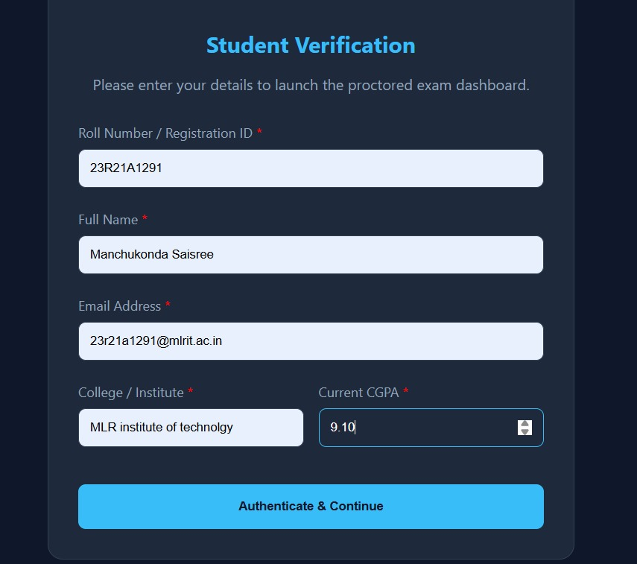
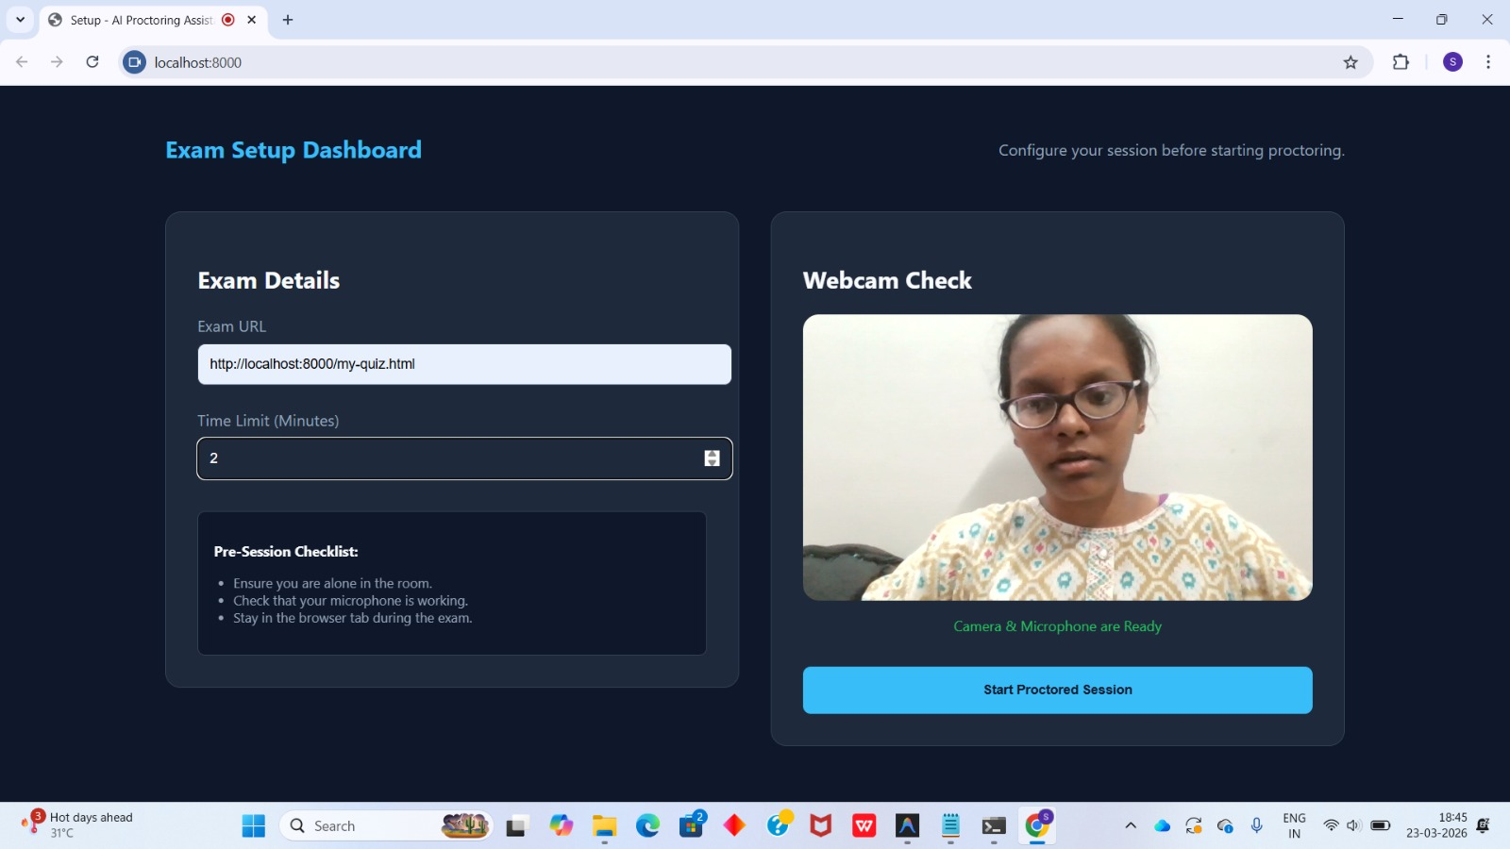
RESULT AND DISCUSSION
Fig : Student Verification & Authentication
Fig : Camera Verification
Team No: 15
17

Slide 18
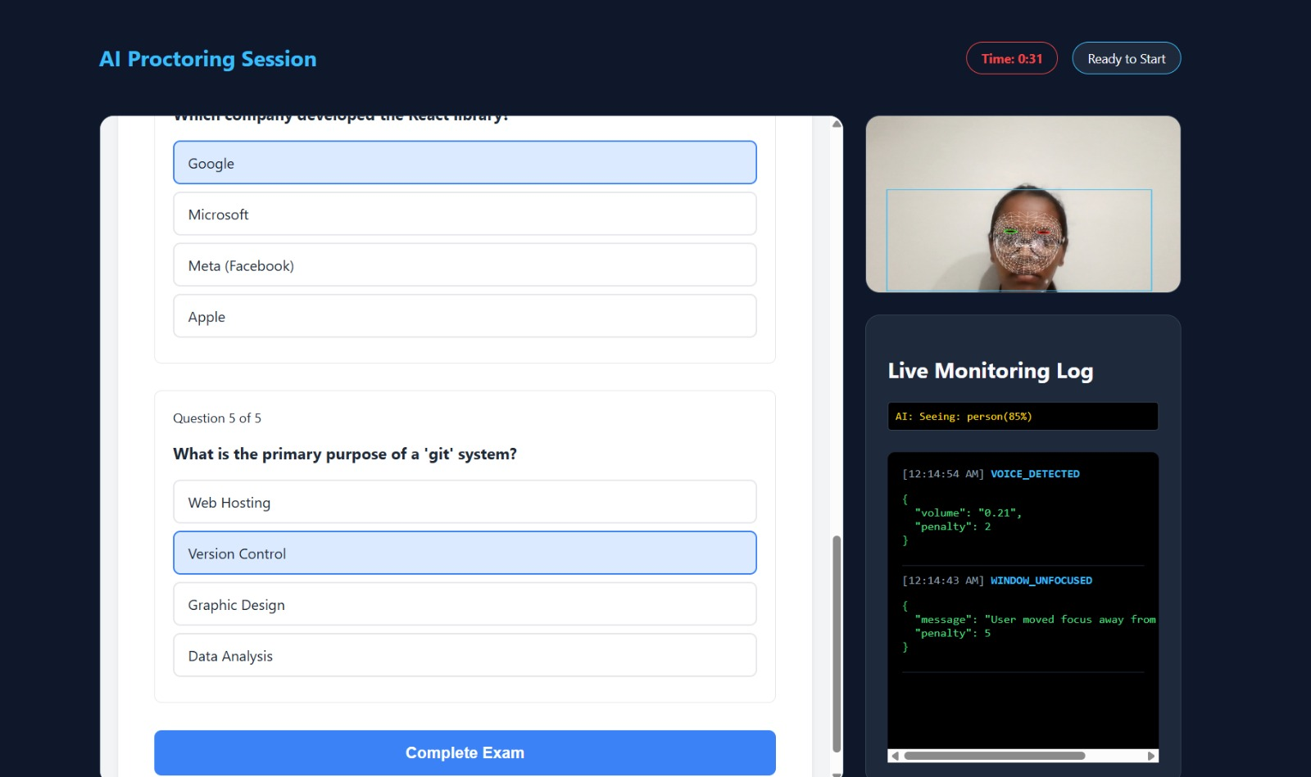
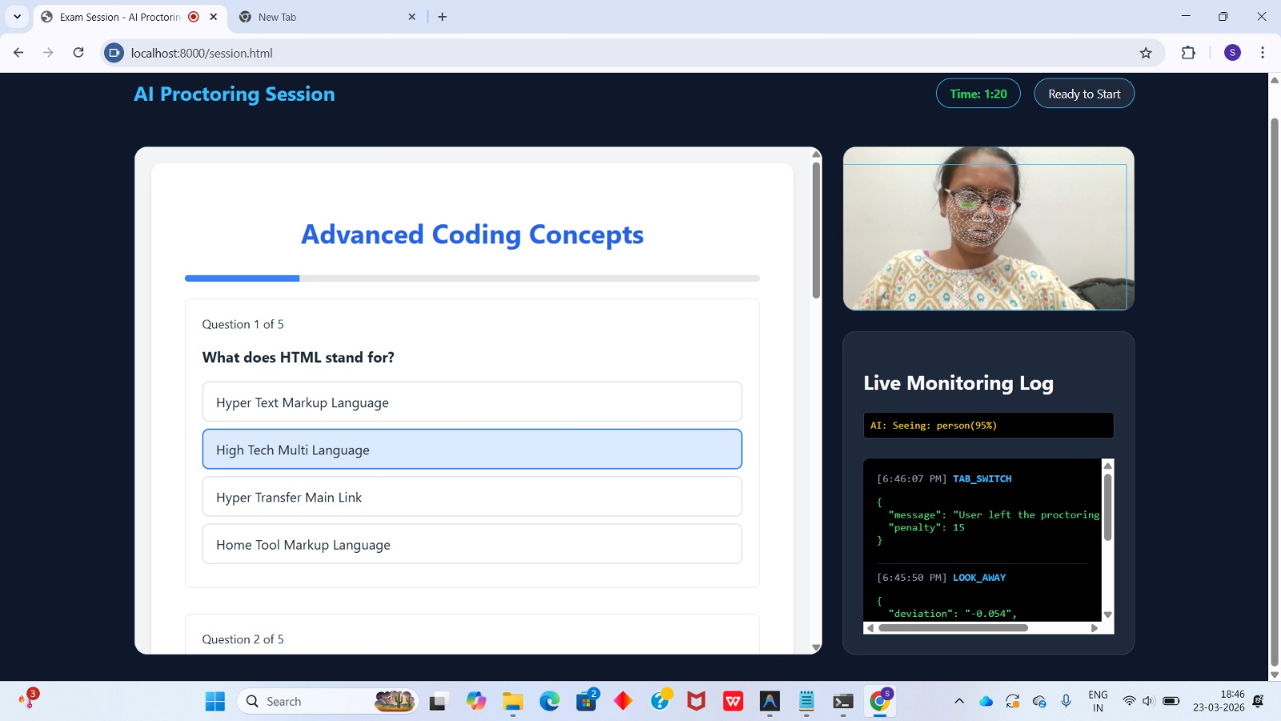
RESULT AND DISCUSSION
Fig : AI Based Proctoring Session
Fig : Face Detection and Monitoring
Team No: 15
18

Slide 19
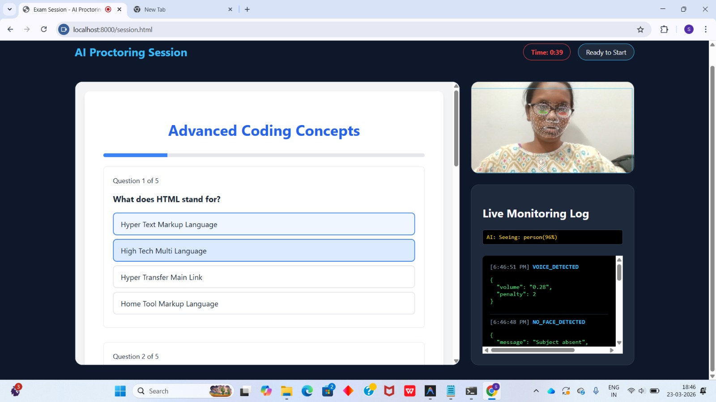
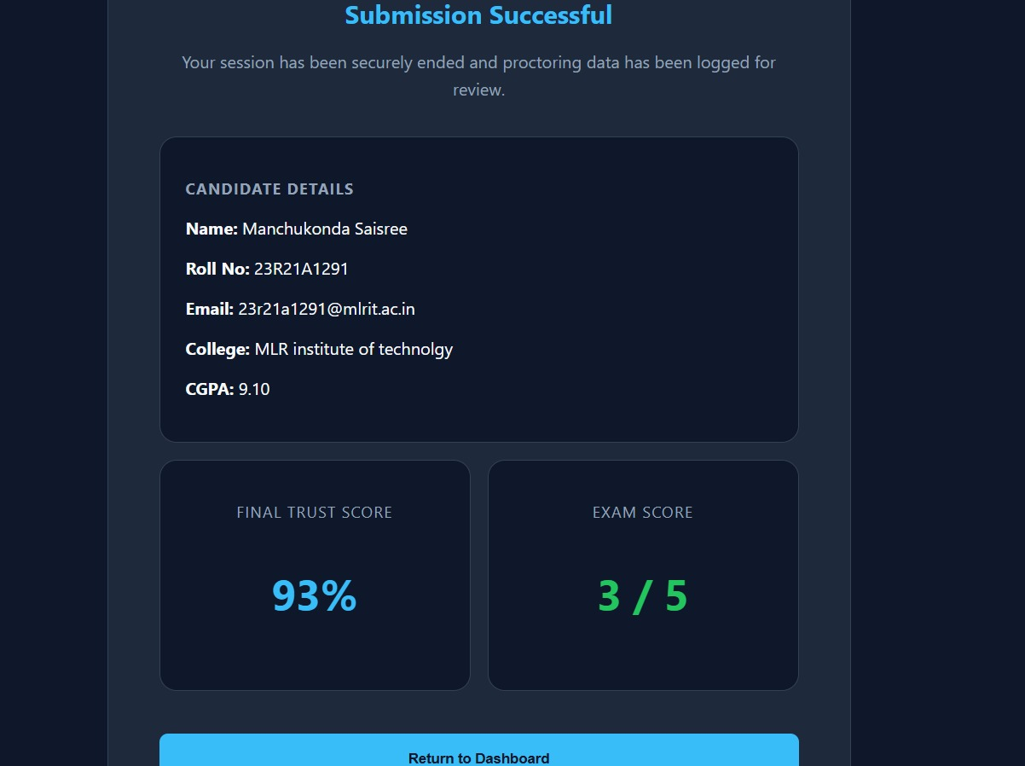
RESULT AND DISCUSSION
Fig : Behavioral Analysis
Fig : Trust Score
Team No: 15
19

Slide 20
CONCLUSION AND FUTURE ENHANCEMENT
The AI-based proctoring system provides an effective and reliable solution for conducting secure online examinations by using technologies like artificial intelligence and computer vision to monitor student behavior and detect cheating activities. It reduces human effort, improves scalability, and ensures fairness and transparency in the examination process. The system successfully identifies suspicious actions such as multiple faces, eye movement, and unauthorized object usage, thereby maintaining exam integrity. In the future, the system can be enhanced by incorporating advanced features such as emotion detection, voice recognition, and improved deep learning models for higher accuracy. It can also be integrated with mobile platforms and learning management systems to make it more accessible and efficient for large-scale use.
Team No: 15
21

Slide 21
REFERENCES
[1] Nigam, A., Pasricha, R., Singh, T., & Churi, P. (2021), “A Systematic Review on AI-Based Proctoring Systems: Past, Present and Future”, Education and Information Technologies, New York, USA: Springer.
[2] Atoum, Y., Chen, L., Liu, A. X., Hsu, S. D. H., & Liu, X. (2017), “Automated Online Exam Proctoring”, IEEE Transactions on Multimedia, pp. 1–12, New York, USA: IEEE.
[3] Motwani, S., Nagpal, C., Motwani, M., & Nagdev, N. (2021), “AI-Based Proctoring System for Online Tests”, SSRN Electronic Journal, New York, USA: Elsevier.
[4] Sridhar, A., & Rajshekhar, J. S. (2022), “AI-Integrated Proctoring System for Online Exams”, Journal of Artificial Intelligence and Capsule Networks, pp. 45–55, New York, USA.
[5] Alessio, H. M., Malay, N., Maurer, K., Bailer, A., & Rubin, B. (2017), “Examining the Effect of Proctoring on Online Test Scores”, Online Learning Journal, pp. 146–161, New York, USA.
Team No: 15
22

Slide 22
THANK YOU
Team No: 15

